Slide 1
Yelp Recommender System
Final Project Presentation
MScA Big Data Platform
Zhuofan Dong

Slide 2

Agenda
Business Problem
Executive Summary
Data Profile
Data Infrastructure
Data Exploration
EDA
Statistical Tests for Assumptions
Sentimental Analysis
Logistic Regression
Random Forest
Gradient Boost Classifier
Recommender System
Association Mining
ALS
Results
Improvements

Slide 3


Executive Summary
Yelp is emerging as the leading consumer review site for many types of businesses. Being on Yelp helps businesses attract customers and customers also enjoy the great services after reviewing the information provided by Yelp.
The goal is to build a recommendation system to recommend restaurants for users.

Slide 4
Data Profile
Source
Description
Size
Format
Business
Yelp
Contains business Data
113.4 MB
JSON
Review
Yelp
Contains Reviews Data
4.98 GB
JSON
User
Yelp
Contains Users Data
3.13 GB
JSON
Total
8.22 GB

Slide 5



Data Dimension

Slide 6



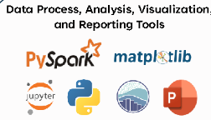

Data Infrastructure

Slide 7
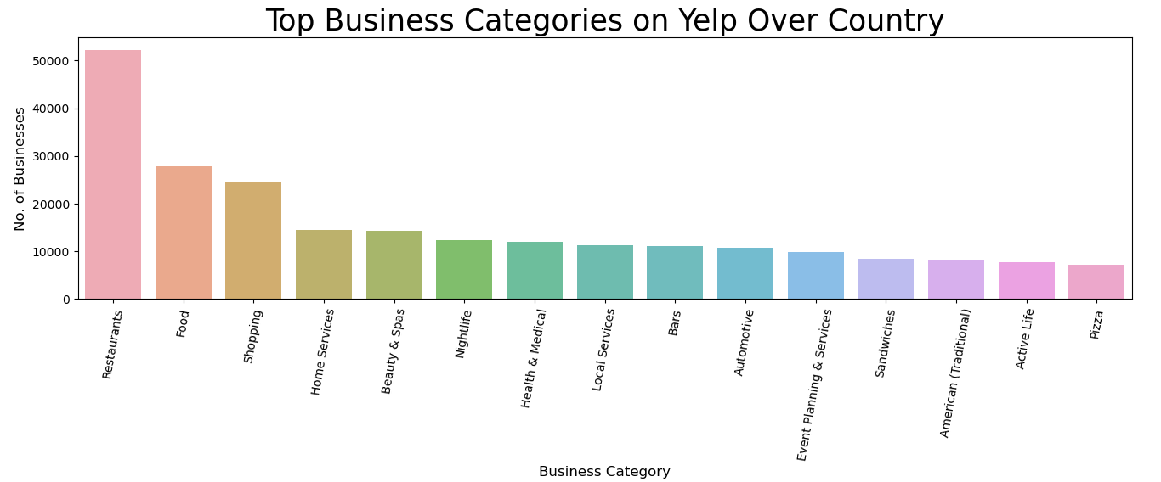
Data Exploration

Slide 8
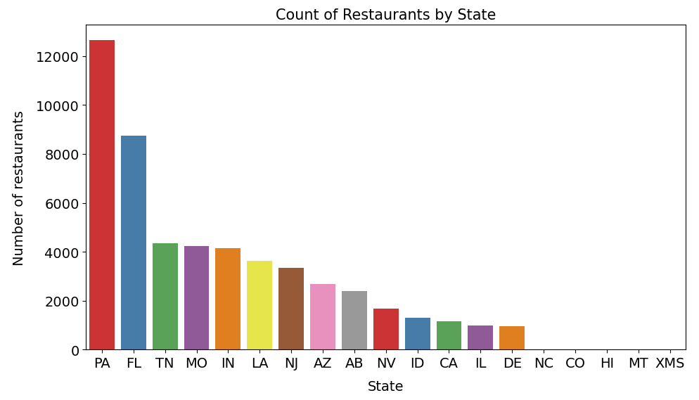
Data Exploration-Business

Slide 9
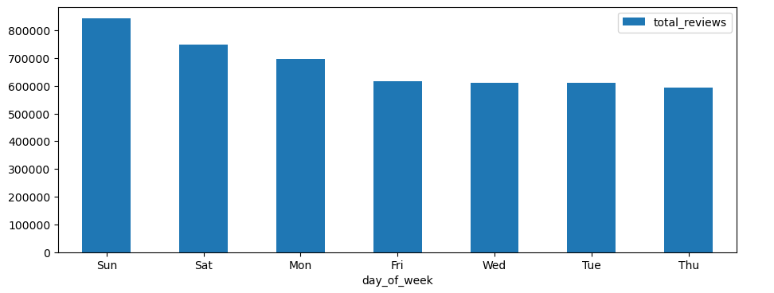
Data Exploration-Reviews

Slide 10
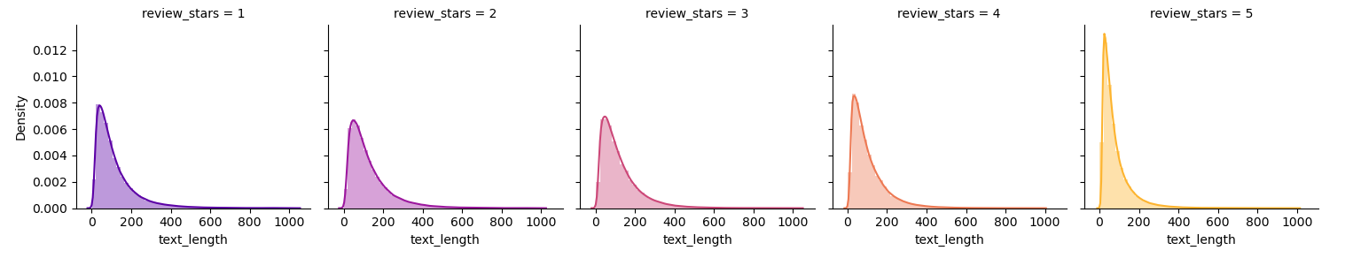
Data Exploration-Reviews
According to the Distribution, we determine the text length of our training data

Slide 11
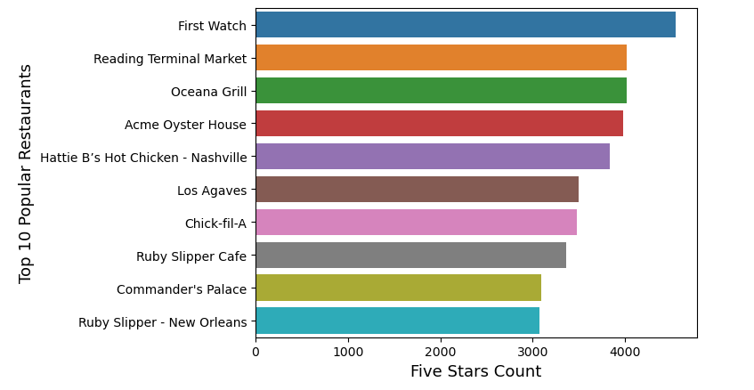
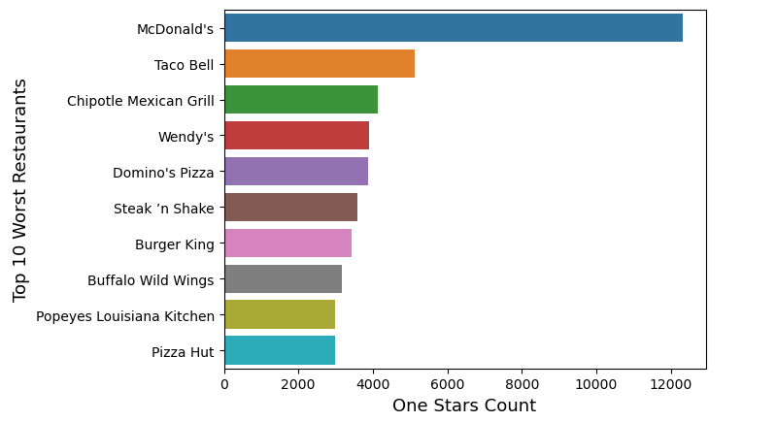
Data Exploration-Reviews
Over the Country

Slide 12
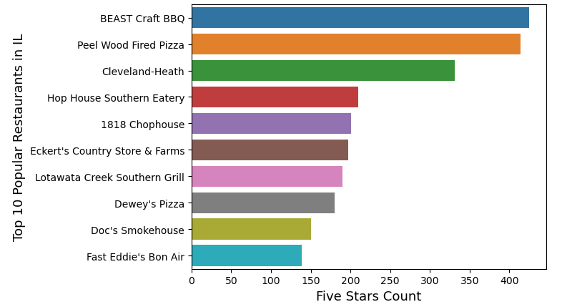
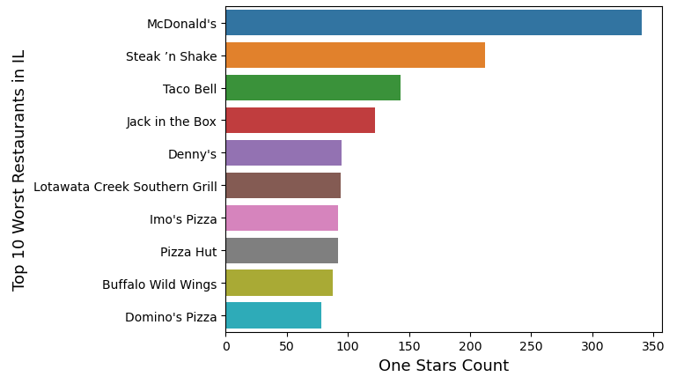
Data Exploration-Reviews
Over the Illinois

Slide 13
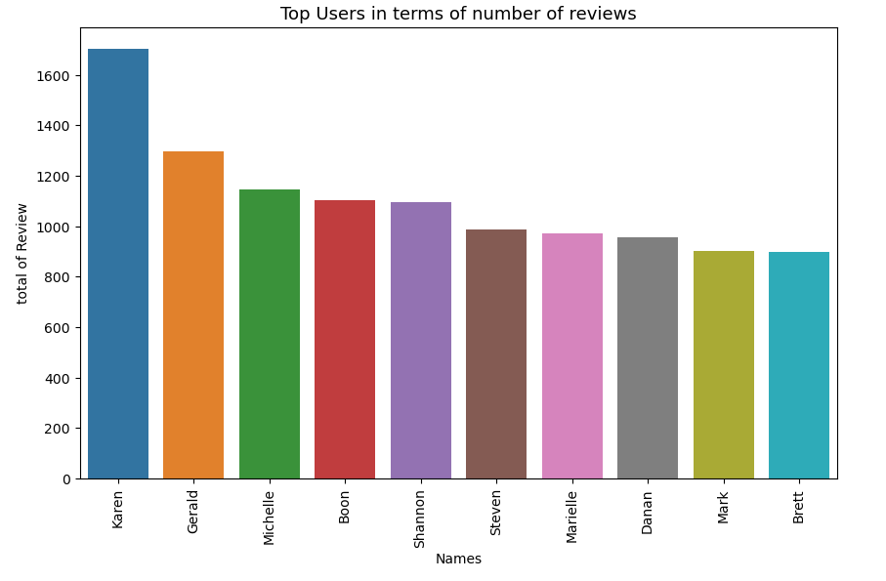
Data Exploration-Users

Slide 14

Data Insights
1. Firstly, do all the users write reviews on Yelp after they experienced the service, or only very satisfied or unsatisfied experiences would make users comment on Yelp?
2. How do we differentiate good reviews than those bad reviews, such as reviews from competitors?

Slide 15
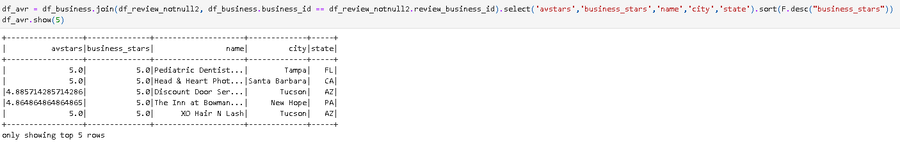
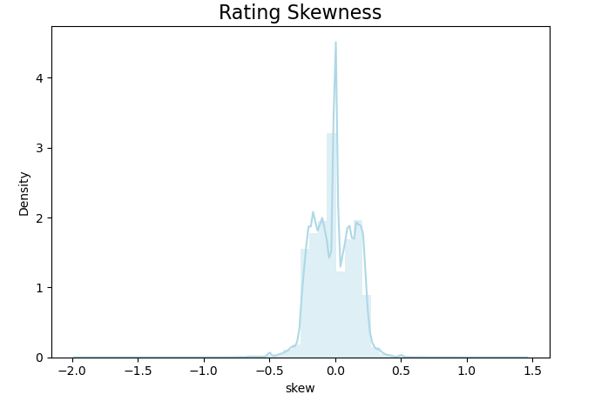
Data Insights-First Question
Difference = AverageStar - BusinessStar

Slide 16
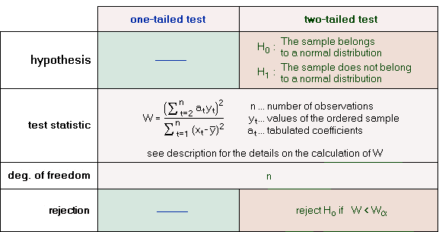
Data Insights-First Question
Shapiro Wilk Test for Normality

Slide 17



Data Insights-First Question
Non-parametric Statistics Test – Wilcoxon Rank Sum Test
This implies that the mean of rating by user with text review submitted are different from the average rating by all users. In this case, average rating is lower than the other. We probably want to only include rates with written reviews.

Slide 18
Data Insights-Second Question
Elite: The Yelp Elite Squad is a way of recognizing people who are active in the Yelp community and role models on and off the Yelp site. Elite-worthiness is based on several things, including well-written reviews, high quality photos, a detailed personal profile, and a history of playing well with others.
Problem: If there are differences between elite average stars and non-elite average stars, we may only use the reviews from Elite Members

Slide 19
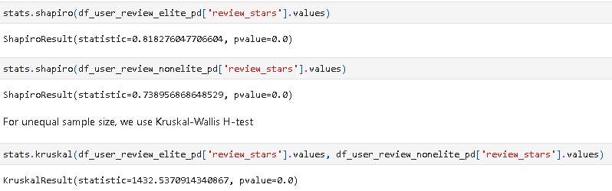
Data Insights-Second Question
Conclusion: The differences are significant.

Slide 20
Data Insights- Data Modeling
Users are mostly driven to post a review on Yelp when they are very satisfied with the experience they have with these businesses (ratings = 5 and 4).
Only use select reviews for restaurant businesses.
Only select reviews that are labelled as useful by at least one user.
Only select positive reviews (rated as 4 or 5 stars) and negative reviews (rated as 1 or 2 stars), exclude neutral reviews (rated as 3 stars).

Slide 21
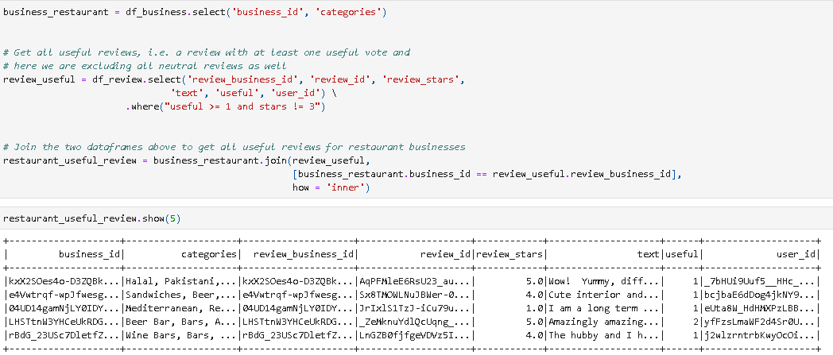
Sentimental Analysis
Review_Stars ~ Reviews

Slide 22
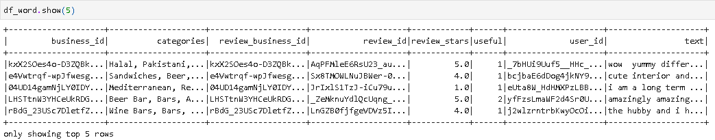
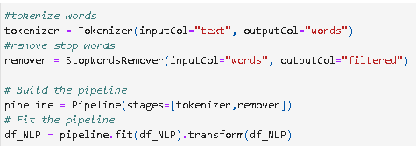
Sentimental Analysis
Review_Stars ~ Reviews

Slide 23
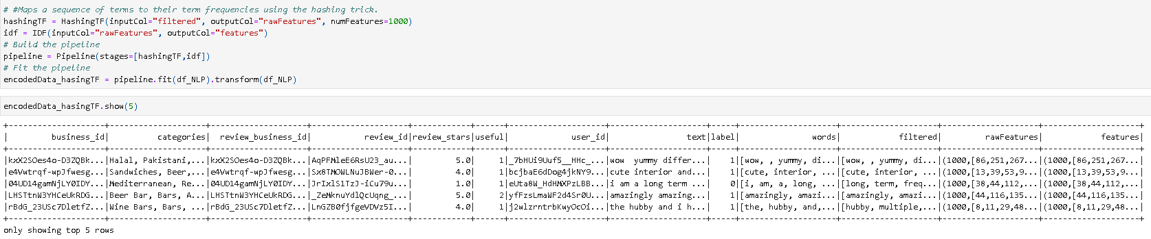
Sentimental Analysis
Hashing-TF allows us to finish the project quick and dirty. In the real development, we always want to try something easy to implement to get some results as quick as possible.

Slide 24
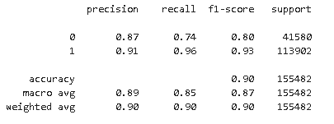
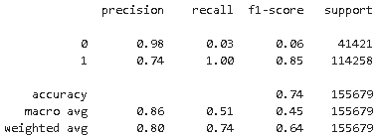
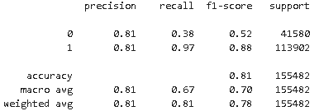
Sentimental Analysis-Models
Logistic Regression > Random Forest > Gradient Boost
Logistic Regression
Random Forest
Gradient Boost Classifier
This can be used for user's experience prediction. If the predicted value is 0, we can send them a follow-up questionnaire and ask them to rate and comment our service.

Slide 25
Improvements
Use CountVectorizer and try the algorithms again
Try more models such as SVM, Neural Network or Naïve Baysian with Laplace Smoothing
Normalize the input data
Hyperparameter Tuning

Slide 26
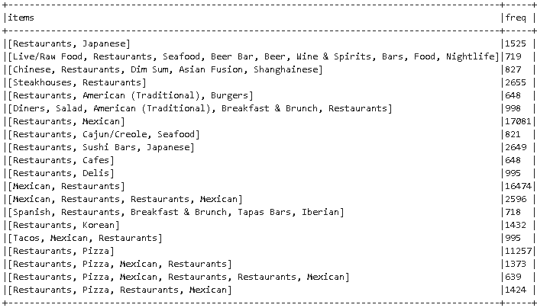
Recommendation System-Associative Mining
Frequent Itemsets

Slide 27
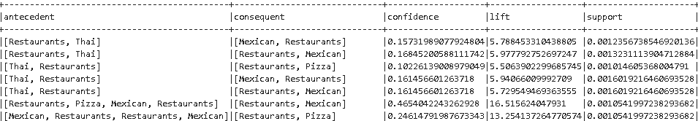
Recommendation System-Associative Mining
Association Rules

Slide 28
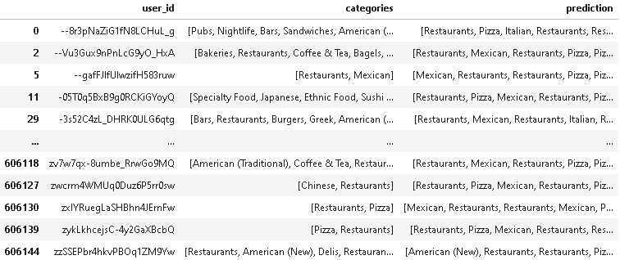
Recommendation System-Associative Mining
Prediction

Slide 29
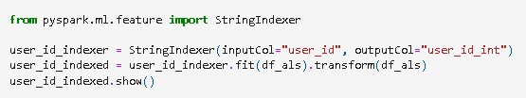

Recommendation System-ALS
Data Preparation

Slide 30
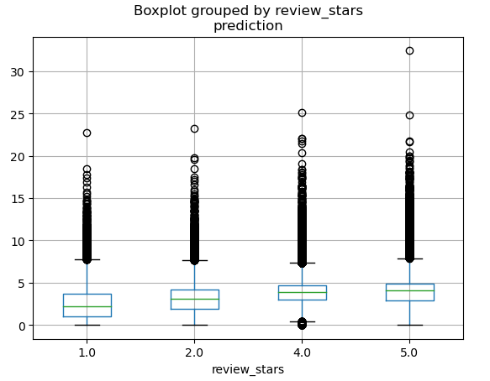
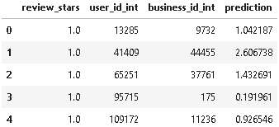

Recommendation System-ALS
Prediction
RMSE = 1.974184
R^2 = -1.094782

Slide 31
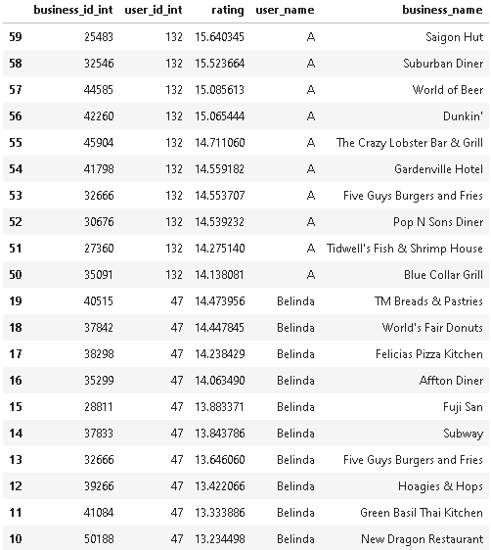
Recommendation System-ALS

Slide 32
Improvements
R^2 suggests that ALS is not the right model to use. We should try other models.
Hyperparameter Tuning to find the best model out of given parameter space.

